Slide 1
XQS: a native XQuery Schematron implementation
Andrew Sales
Markup UK, 3rd June 2023

Slide 2
Agenda(?)
What it is
Why do it
Design goals
[…]
Notes:
What are we going to cover today?
[…]

Slide 3
About me
Project editor, ISO/IEC 19757-3
Convenor, ISO/IEC JTC 1/SC 34/WG 10
Work at publisher based in London
Notes:
First, a little about me.

Slide 4
About XQS
XQS = XQuery for Schematron
Pronounced /ɛksˈkjuːz/
Written in pure XQuery
BaseX dialect of 3.1
Tested under BaseX 10.x
Notes:
Acronym stands for Xquery for Schematron
But pronounced “excuse”

Slide 5
Why do this?
ISO approved new work to revise standard
Second “reference” implementation
XQuery QLB reserved, but not defined
Rapid development?
Advocacy at meetups
End-user benefits
Notes:
Where did the motivation come from?
ISO approved revision in Sep ’22
No ref impl required by ISO, but having another makes sense, in particular in a different language
Xquery is the obvious choice: query language binding specified but not defined
Hope to learn better what that QLB should look like by doing this!
Appeal of rapid dev – concise & declarative syntax
Have urged community to produce more impls -- time to step up myself
End user: integration into Xquery-based system/workflow

Slide 6
What design goals?
Conformance over performance
No optimization at this stage
”Dynamic evaluation” of schemas
Portability of “compiled” schemas
(SVRL output)
Notes:
Conformance over performance: this is where the impl is not just native, but naïve Xquery
“Dynamic evaluation” – come back to that in a moment
“Compiled” schemas produced by this software to be portable between engines as far as poss
Although not mandated by the standard, SVRL output

Slide 7
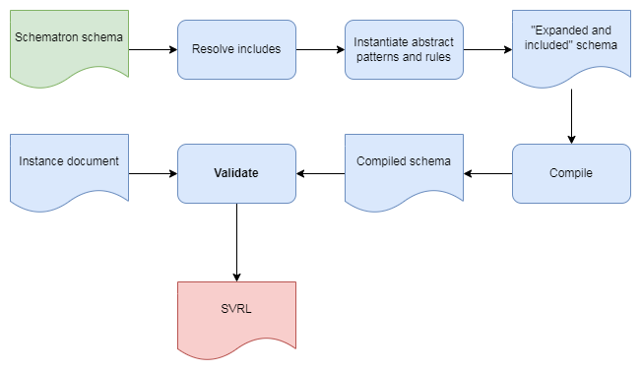
Typical processing
Notes:
- Re dynamic evaluation, this is what the processing model looks like for e.g. XSLT impls

Slide 8
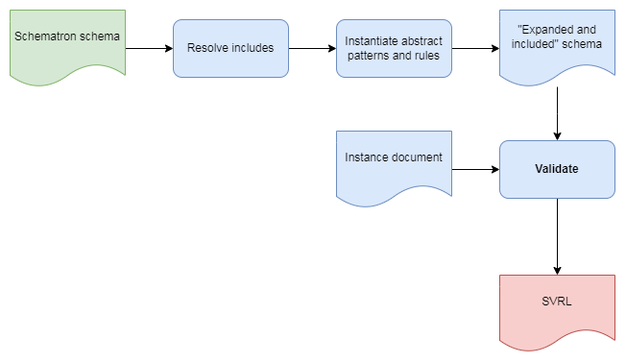
Dynamic evaluation
Notes:
Pre-processing steps still in place, but no compilation step
Q. Why? A. no absolute need for compile step, so curious what it would through up doing it this way; also: previous experience of XMLProbe/Probatron (XPath impl)

Slide 9
How to do this?

Slide 10
Ask ChatGPT!

Slide 11

Credit: Victor Metelskiy/Shutterstock

Slide 12
"Implement Schematron in XQuery"
let $schematron := <schema xmlns="http://www.ascc.net/xml/schematron">[...]
let $assertions := $schematron//sch:assert
return (
every $assert in $assertions satisfies (
let $test := $assert/@test
return (
if (exists($assert/@role) and $assert/@role = 'warning') then
count($xml[not($test)]) eq 0
else
exists($xml[$test])
)
)
Notes:
Joking aside: this isn’t a conference about AI, but let’s see what it said.
First question.
(Answer is shortened, for space reasons)
Reasonable attempt – Boolean result, though.
No handling of patterns or rules
Q. Can anyone spot what’s odd here?
A. Pre-ISO namespace!!

Slide 13
“Implement ISO Schematron in XQuery 3.1"
declare namespace sch = "http://purl.oclc.org/dsdl/schematron";
declare function local:schematron($xml as node(), $schematron as node()) as xs:boolean {
let $schematronXSLT := $schematron/sch:schema/xsl:stylesheet
let $assertions := $schematronXSLT/sch:pattern/sch:rule/sch:assert
let $reports := $schematronXSLT/sch:pattern/sch:rule/sch:report
let $transformed := transform(
$xml,
$schematronXSLT,
map { 'validation-mode': 'lax' }
)
[...]
Notes:
So I asked specifically for ISO SCH and XQY 3.1, to see if that made a difference.
This time, it proudly declares the ISO namespace (see top).
BUT it uses the XSLT impl!

Slide 14
"Implement natively [etc.]"
declare namespace sch = "http://purl.oclc.org/dsdl/schematron";
let $assertions := $schematron//sch:assert
return (
every $assert in $assertions satisfies (
let $test := $assert/@test
return (
if (exists($assert/@role) and $assert/@role = 'warning') then
count($xml[not($test)]) eq 0
else
exists($xml[$test])
)
)
Notes:
Same approach as at first, but in ISO namespace…

Slide 15
“Now include an SVRL report"
for $assert in $assertions return
if (exists($assert/@role) and $assert/@role = 'warning') then
if (count($xml[not($assert/@test)]) eq 0) then ()
else
<svrl:failed-assert test="{$assert/@test}" role="warning">
<svrl:text>{data($assert)}</svrl:text>
</svrl:failed-assert>
else
if (exists($xml[$assert/@test])) then ()
else
<svrl:failed-assert test="{$assert/@test}">
<svrl:text>{data($assert)}</svrl:text>
</svrl:failed-assert>
Notes:
Now SVRL appears, but still no pattern/rule handling, so no complete SVRL output.

Slide 16
How asking ChatGPT helped
ISO; XQuery; SVRL

Slide 17
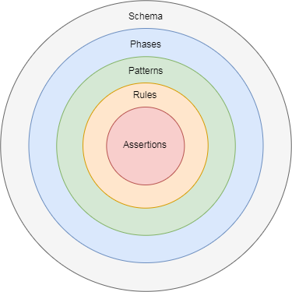
Schema structure
Notes:
Before diving into approach, an overview of Schematron schema structure:
Phase, pattern, rule, constraints (diagram)

Slide 18
Processing model
Include, expand, compile

Slide 19
Caveats
No expansion/inclusion & WHY
BUT dynamic evaluation as well as compilation

Slide 20
Evaluate vs compile
[diagram the two approaches]

Slide 21
Questions?
[github link]
[contact details]

